Slide 1
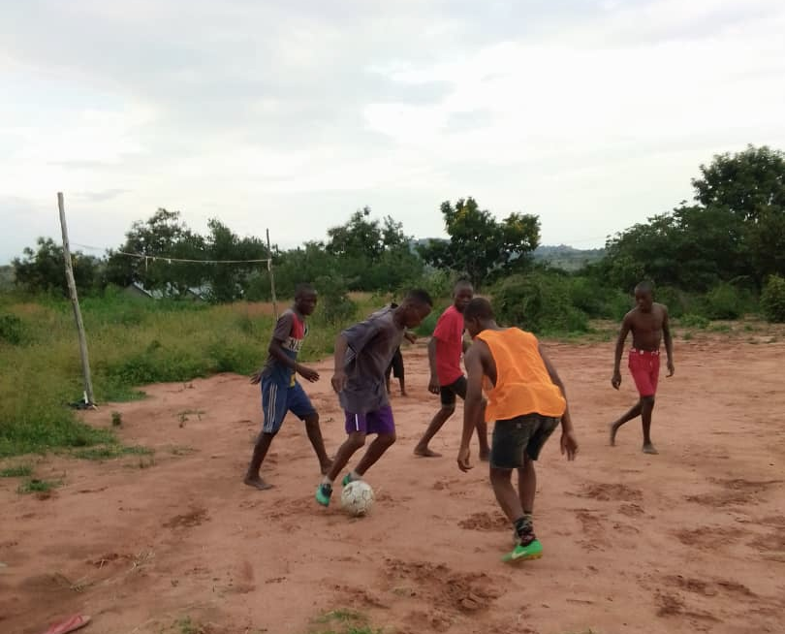
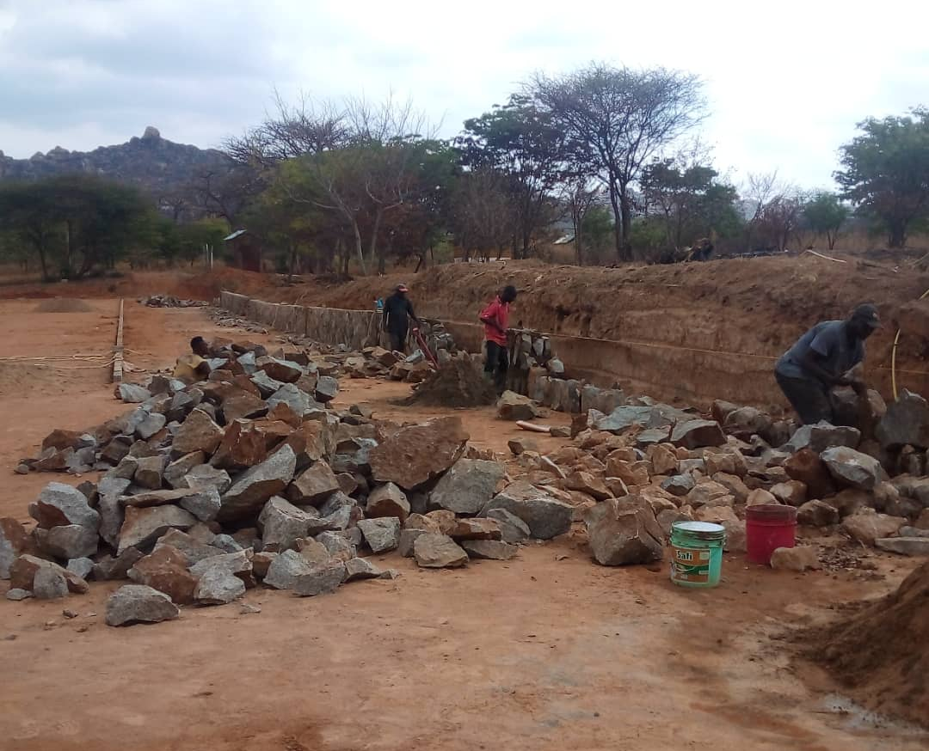
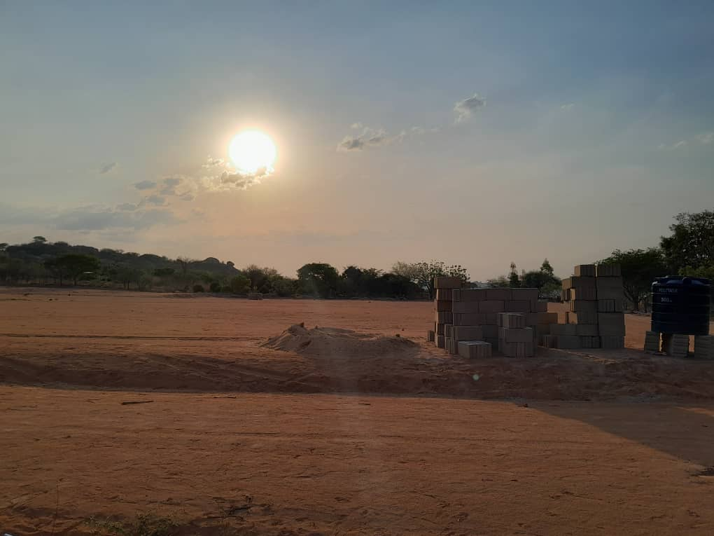
Mchezo Oyee - Viva lo sport
Project funded by

Slide 2
⛹ introduction
Lead Organization: Gruppo Tanzania Onlus Duration: 12 months (January–December 2025) Country: Tanzania Location: Chigongwe Family, at the partner organization KISEDET NGO - P.O. Box 379 Dodoma
Goal: Establishment of a sports center within the Chigongwe Family shelter for street children (Tanzania) in order to:
Facilitate the physical and psychological recovery of street children hosted at the centre.
Provide new sports opportunities for boys and girls in the village of Chigongwe, promoting useful sports education and mutual social integration for all.

Slide 3
⛹ context
Chigongwe Family is a long-term shelter community for minors, located in a rural village 25 km west of Dodoma, the capital of Tanzania.
The Chigongwe facility operates alongside the short-term shelter community Shukurani and the Drop-In Center for street children and youth in Dodoma. Together, they form a comprehensive care system focused on supporting children and adolescents in difficult situations— including minors living and working on the streets— and, whenever possible, facilitating family reunification through the collaboration between social workers, psychologists, and governmental social services.
In addition to its accommodation services, currently offering 24 places for minors and a rest house, the community provides educational and recreational activities such as yoga sessions and drawing therapy. It also runs projects like vegetable gardens, a tree nursery, a poultry farm, two fish farming tanks, and the ongoing construction of a sports field.

Slide 4
⛹ the project
The project aims to provide the children from the shelter and the surrounding village with the opportunity to practice sports in proper conditions, with special attention to girls, who are often not encouraged to participate in such activities.
This initiative will enhance the effectiveness of KISEDET’s educational program, foster positive relationships between the children at the shelter and those from the village, and create new training opportunities in sports—especially for the girls of Chigongwe. Additionally, it will increase the center’s self-sustainability by renting out the field for training sessions to local teams.
Previously, Chigongwe Family had only an uncultivated plot of land used as a makeshift soccer field. To address this, the project envisions the construction of a multifunctional sports center within the area, including:
A grass field (45 x 90 m) connected to the community's irrigation system, with two iron goalposts.
A clay field (30 x 60 m) with two iron goalposts.
A multipurpose court (15 x 30 m) for basketball, volleyball, and netball, equipped with necessary sports gear.
A shower and changing room block, along with perimeter fencing.
Sports equipment for the children at the shelter.
Training courses for local staff and the children at the center.

Slide 5
⛹ Partner
The community is one of the key areas of work for KISEDET NGO, a Tanzanian non-governmental organization that provides support services for street children and youth, minors under the care of governmental social services, and disadvantaged families. KISEDET also offers education and training programs—including for individuals with disabilities—and facilitates microcredit groups.
Additionally, the organization manages sponsorship programs, a responsible tourism initiative, and a fair trade shopin collaboration with its Italian partner, Gruppo Tanzania Onlus.
The work of both organizations is supported by partnerships with various entities, such as Progetto Agata Smeralda and the Waldensian Church, as well as other associations and private donors.
KISEDET has also participated in collaborative programs with international organizations, including USAID/PACT and Railway Children Africa.

Slide 6
