Slide 1
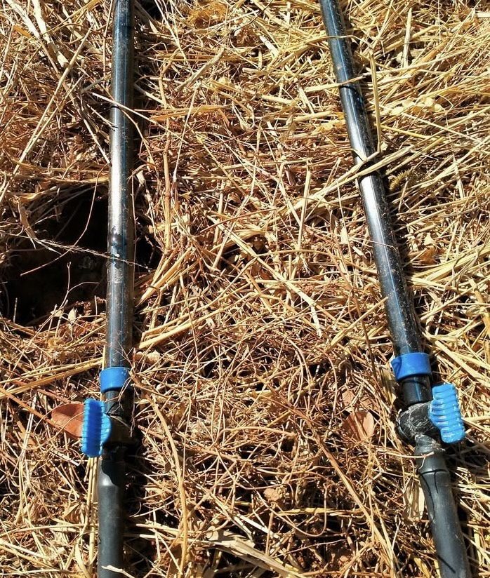

Project for the Enhancement of Agricultural Activities at the Long-Term Centre – Chigongwe Family
Thanks to the support of the 8x1000 fund from the Waldensian Church, the project to improve agricultural techniques at our site in Chigongwe has been completed.
In the following slides, we present the important milestones achieved.

Slide 2
What has been accomplished thanks to the 8x1000 funds from the Waldensian Church?
An underground water collection tank connected to reservoirs distributed across the cultivated area;
A new drip irrigation system;
An incubator to help increase poultry production;
A new chicken coop that provides a safe and suitable environment for poultry farming.

Slide 3
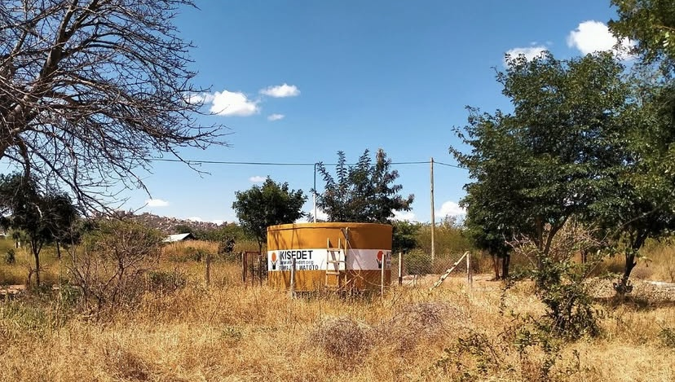
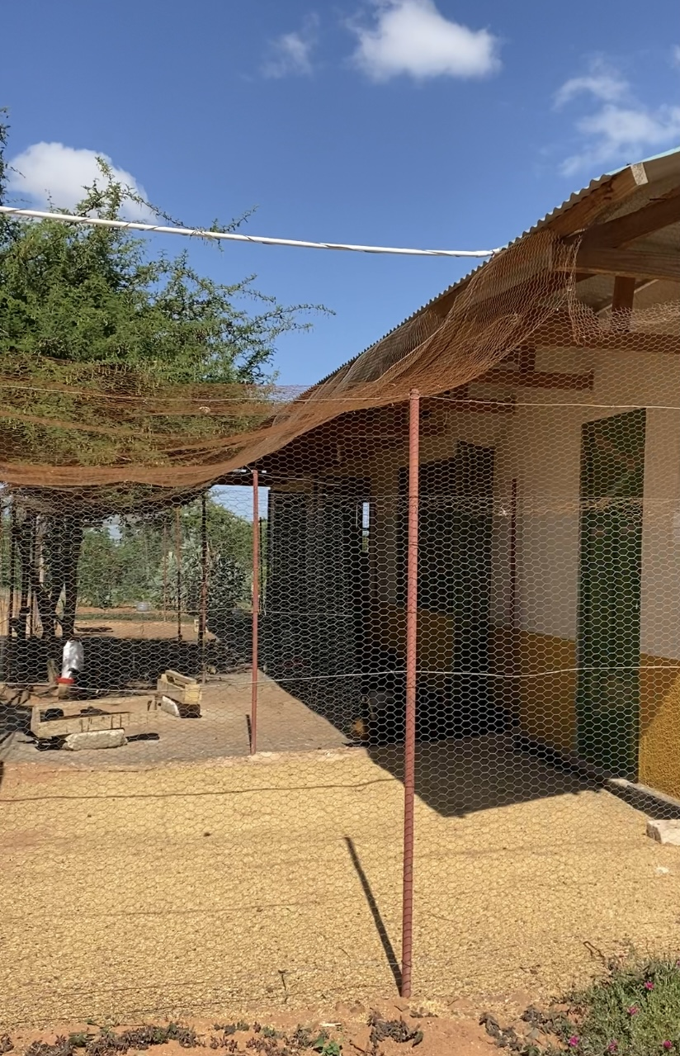
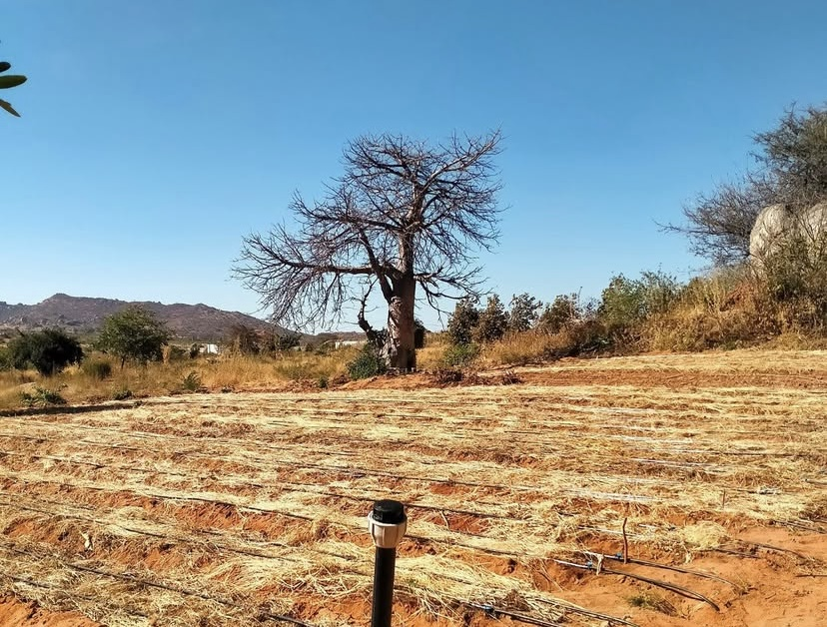
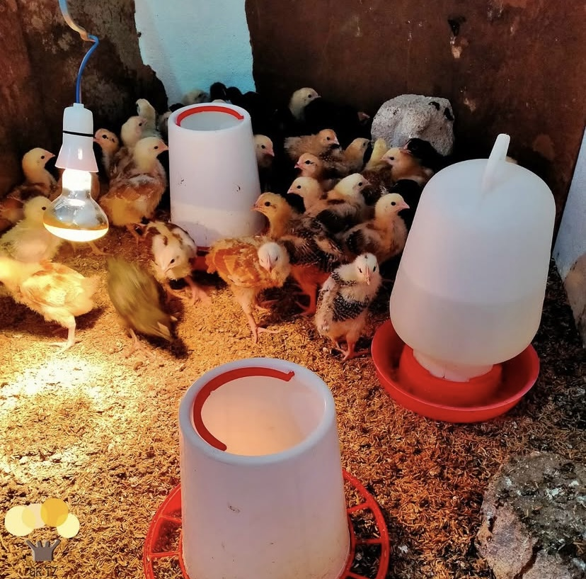

Slide 4
What are the benefits of these new infrasctuctures?
The construction of these new infrastructures ensures a healthy and balanced diet for the entire Chigongwe Family community, including children, young people, and staff members.
These infrastructures also provide an income for the reception center through the sale of food products such as chickens, eggs, and various agricultural goods.
The center is moving towards an increasingly sustainable approach to agriculture and livestock farming from an economic perspective.
At Chigongwe Family, environmental respect and the responsible use of natural resources without waste are central—both to protect the local territory and to promote education on respecting nature within the community.

Slide 5



This project was carried out thanks to the 8x1000 funding from the Waldensian Church to Gruppo Tanzania Onlus, the Italian partner of KISEDET NGO.
Gruppo Tanzania Onlus was established in 1998 to raise funds for KISEDET.
The project to enhance agricultural activities was implemented in all its phases by KISEDET NGO.

