Slide 1
‘EDEN - Education and Engagement’
Ipsos Foundation & KISEDET
Supporting children and families in Tanzania
by helping them to gain access to education

Slide 2
Who Are We Helping?
A group of 30 children
between the ages of
5 to 17 years, 10 teenagers and
40 families
from rural areas
in Tanzania.

Slide 3
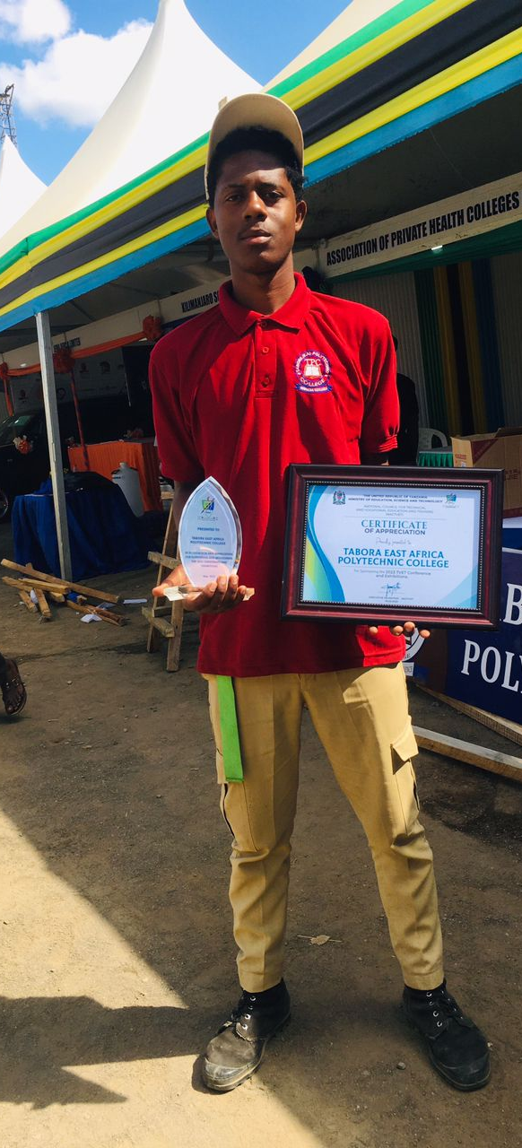
How Are We Helping?
Access to education
Access to training centers or apprenticeship
Family reunification
Community engagement supporting vulnerable parents

Slide 4
THIS PROJECT IS FUNDED BY IPSOS

