Slide 1
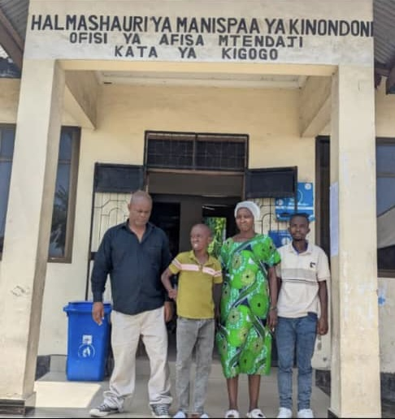
WISE project
Carried out by 8x1000 & KISEDET

Slide 2
WISE project introduction
Duration of the project: 12 months
City of implementation: Dodoma, Tanzania
Field of action: protection of children
Beneficiaries: 40 children aged 4-14 years old (25 living inside Shukurani short-term shelter and 15 attending KISEDET's daily drop-in centre); 40 families composed of at least one children's relative (25 living inside the Region of Dodoma and 15 living outside the Region)

Slide 3
WISE’s main goals
to provide psychological counselling to the children who were living and working on the streets and who were victims of forced labour or abuses, to ensure their psychological wellbeing;
to trace and train children's families through visits held by a professional social worker: these visits are aimed at the sensibilisation of relatives and caregivers, with the final goal of limiting the causes that push children out of their homes;
to reunify children with families while also providing economic support for school uniforms and health insurance.

Slide 4
Child Reunification & Reintegration (December 2024 report)
Reunification Process:
Local and long-distance reunifications, supported by government authorities at grassroots levels (Mtaa Executive Officer, Chairperson, and Ward Social Welfare Officers).
Core services included school enrolment and reenrolment, as well as vocational training.
Total Reunifications: 32 children reunited with safe families (local & long-distance).
Education & Vocational Training:30 children re-enrolled in formal schools (1 in secondary, 29 in primary) 2 children enrolled in vocational training.
Key Stakeholders:
Government authorities (Mtaa Executive Officer, Chairperson, Ward Social Welfare Officers).
NGOs: Safina Street Network & Upendo Daima.
WISE was a project funded by
and implemented by

